Slide 1

Fault-Tolerant Computing
Dealing with Low-Level Impairments

Slide 2
About This Presentation
This presentation has been prepared for the graduate course ECE 257A (Fault-Tolerant Computing) by Behrooz Parhami, Professor of Electrical and Computer Engineering at University of California, Santa Barbara. The material contained herein can be used freely in classroom teaching or any other educational setting. Unauthorized uses are prohibited. © Behrooz Parhami
Edition | Released | Revised | Revised
First | Oct. 2006

Slide 3

Fault Testing

Slide 4
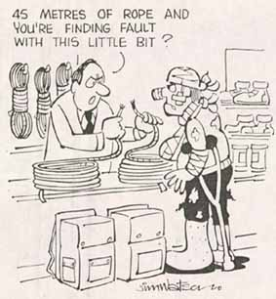



The good news is that
the tests don’t show
any other problems

Slide 5
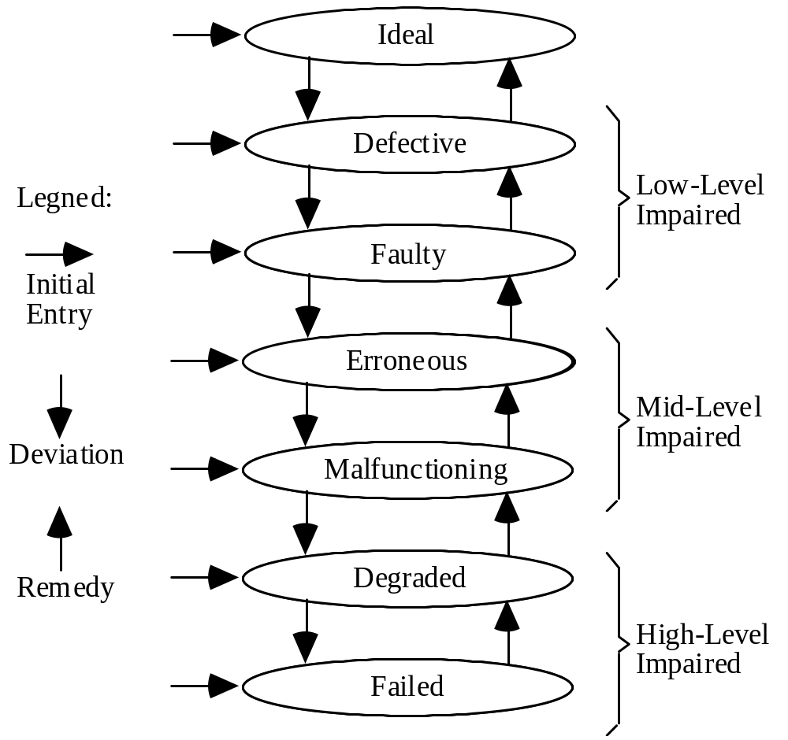
Multilevel Model
Component
Legend:
Next lecture
Logic
Entry
Today
Information
System
Service
Result
Tolerance

Slide 6
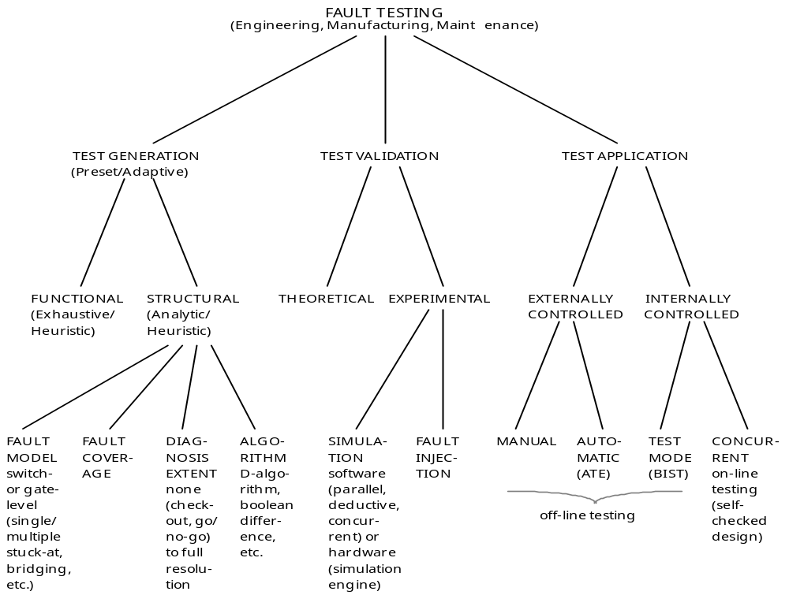
Overview of Fault Testing
FAULT TESTING
(Engineering, Manufacturing, Maintenance)
Correct
design?
Correct
implementation?
Correct
Operation?
Notes:
Parhami, B., “A Multi-Level View of Dependable Computing,” Computers & Electrical Engineering, Vol. 20, No. 4, pp. 347-368, 1994.

Slide 7
Requirements and Setup for Testing
Easier to test if direct access to
some inner points is possible
Reference value
Test pattern
source
Circuit under test
(CUT)
Comparator
Pass/Fail
Testability requires controllability and observability
(redundancy may reduce testability if we are not careful; e.g., TMR)
Reference value can come from a “gold” version or from a table
Test patterns may be randomly generated, come from a preset list, or be selected according to previous test outcomes
Test results may be compressed into a “signature” before comparing
Test application may be off-line or on-line (concurrent)
Notes:
Fujiwara, H., Logic Testing and Design for Testability, MIT Press, 1985.

Slide 8
Importance and Limitations of Testing
Important to detect faults as early as possible
Approximate cost of catching a fault at various levels
Component $1
Board $10
System $100
Field $1000
Test coverage may be well below 100% (model inaccuracies and impossibility of dealing with all combinations of the modeled faults)
“Trying to improve software quality by increasing the amount of testing is like trying to lose weight by weighing yourself more often.”
Steve C. McConnell
“Program testing can be used to show the presence of bugs,
but never to show their absence!” Edsger W. Dijkstra

Slide 9
Fault Models at Different Abstraction Levels
Fault model is an abstract specification of the types of deviations in logic values that one expects in the circuit under test
Can be specified at various levels: transistor, gate, function, system
Transistor-level faults
Caused by defects, shorts/opens, electromigration, transients, . . .
May lead to high current, incorrect output, intermediate voltage, . . .
Modeled as stuck-on/off, bridging, delay, coupling, crosstalk faults
Quickly become intractable because of the large model space
Function-level faults
Selected in an ad hoc manner based on the function of a block
(decoder, ALU, memory)
System-level faults (malfunctions, in our terminology)
Will discuss later in section dealing with mid-level impairments

Slide 10
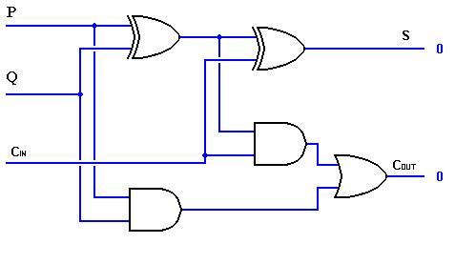
Gate- or Logic-Level Fault Models
Most popular models (due to their accuracy and relative tractability)
Line stuck faults
Stuck-at-0 (s-a-0)
Stuck-at-1 (s-a-1)
A
S
B
Short
(OR)
s-a-0
Line bridging faults
Unintended connection
(wired OR/AND)
C
K
Open
Line open faults
Often can be modeled as s-a-0 or s-a-1
Delay faults (less tractable than the previous fault types)
Signals experience unusual delays
Other faults
Coupling, crosstalk

Slide 11
Path Sensitization and D-Algorithm
The main idea behind test design: control the faulty point from inputs and propagate its behavior to some output
Example: s-a-0 fault
Test must force the line to 1
A
1
S
B
1/0
Two possible tests
(A, B, C) = (0 1 1) or (1 0 1)
s-a-0
1/0
C
1/0
1
K
This method is formalized in the D-algorithm
0
Backward trace
Forward trace
(sensitization)
D-calculus
1/0 on the diagram above is represented as D
0/1 is represented as D
Encounters difficulties with XOR gates (PODEM algorithm fixes this)
Notes:
Fujiwara, H., Logic Testing and Design for Testability, MIT Press, 1985.

Slide 12
Selection of a Minimal Test Set
Each input pattern detects a subset of all possible faults of interest (according to our fault model)
A
E
M
N
A B C P Q
s-a-0 s-a-1 s-a-0 s-a-1
0 0 0 - - - x
0 1 1 x - x -
1 0 1 ? ? ? ?
1 1 1 ? ? ? ?
S
G
J
B
P
Q
C
L
F
K
R
H
Choosing a minimal test set is a covering problem
Equivalent faults: e.g., P s-a-0 ≡ L s-a-0 ≡ Q s-a-0
Q s-a-1 ≡ R s-a-1 ≡ K s-a-1

Slide 13
Capabilities and Complexity of D-Algorithm
Reconvergent fan-out
Consider the s input s-a-0
x
1
D
D
1
s
z
Simple path sensitization does not allow us to propagate the fault to the primary output z
y
D
1
PODEM solves the problem by setting y to 0
Worst-case complexity of D-algorithm is exponential in circuit size
Must consider all path combinations
XOR gates cause the behavior to approach the worst case
Average case is much better; quadratic
PODEM: Path-oriented decision making
Developed by Goel in 1981
Also exponential, but in the number of circuit inputs, not its size
Notes:
Fujiwara, H., Logic Testing and Design for Testability, MIT Press, 1985.

Slide 14
Boolean Difference
K = f(A, B, C) = AB ∨ BC ∨ CA
dK/dB = f(A, 0, C) ⊕ f(A, 1, C)
= CA ⊕ (A ∨ C)
= A ⊕ C
E
A
M
N
S
G
J
B
s-a-0
Q
P
K = PC ∨ AB
dK/dP = AB ⊕ (C ∨ AB) = C(AB)
C
L
F
K
R
H
Tests that detect P s-a-0 are solutions to the equation P dK/dP = 1
(A ⊕ B) C(AB) = 1 ⇒ C = 1, A ≠ B
Tests that detect P s-a-1 are solutions to the equation P dK/dP = 1
(A ⊕ B) C(AB) = 1 ⇒ C = 1, A = B = 0
Notes:
Fujiwara, H., Logic Testing and Design for Testability, MIT Press, 1985.

Slide 15
Complexity of Fault Testing
The satisfiability problem (SAT)
Decision problem: Is a Boolean expression satisfiable?
(i.e., can we assign values to the variables to make the result 1?)
Theorem (Cook, 1971): SAT is NP-complete
In fact, even restricted versions of SAT remain NP-complete
According to the Boolean difference formulation, test generation can be converted to SAT (find the solutions to P dK/dP = 1)
To prove the NP-completeness of test generation, we need to show that SAT (or some other NP-complete problem) can be converted to test generation
For a simple proof, see [Fuji85], pp. 113-114
Notes:
Fujiwara, H., Logic Testing and Design for Testability, MIT Press, 1985.

Slide 16
Design for Testability: Combinational
Increase controllability and observability via the insertion of degating mechanisms and control points
Design for dual-mode operation
Normal mode
Test mode
Degate
Control/Observe
Partitioned
design
Normal mode
Test mode
for A
A
B
A
B
A
B
Muxes

Slide 17
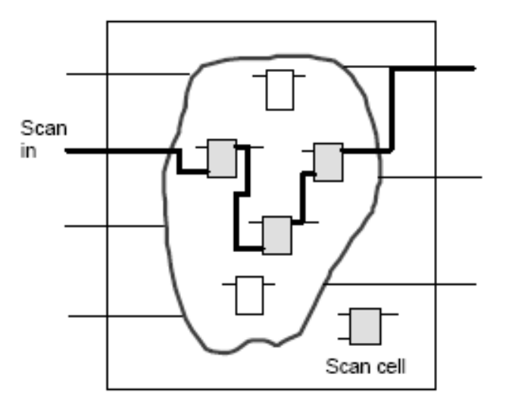
Design for Testability: Sequential
Increase controllability and observability via provision of mechanisms to set and observe internal flip-flops
FF
FF
Scan design
Shift desired states into FF
Shift out FF states to observe
Combinational logic
.
.
.
.
.
.
Mode control
FF
FF
Combinational logic
.
.
.
.
.
.
Partial scan design:
Mitigates the excessive overhead of a full scan design

Slide 18
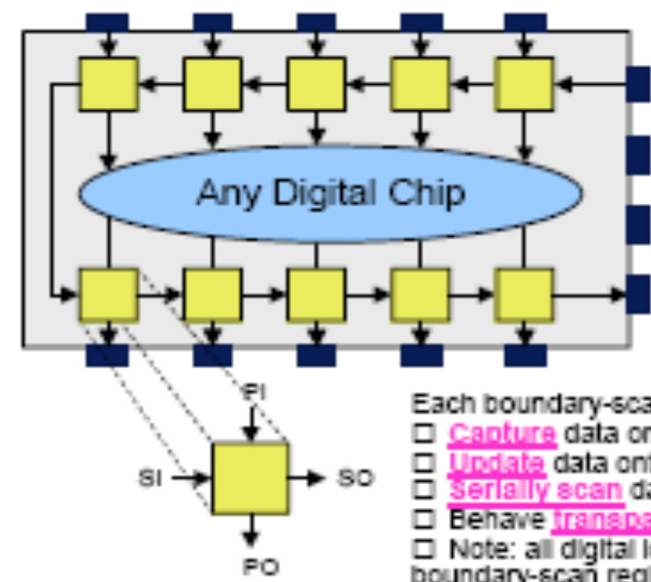
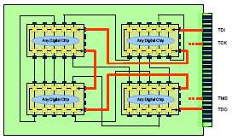
Boundary Scan for Board-Level Testing
Parallel in
Allows us to apply arbitrary inputs to circuit parts whose inputs would otherwise not be externally accessible
Scan in
Any digital circuit
Test clock
Mode select
Scan out
Parallel out
Boundary scan elements of multiple parts are cascaded together into a scan path
From: http://www.asset-intertech.com/pdfs/boundaryscan_tutorial.pdf

Slide 19
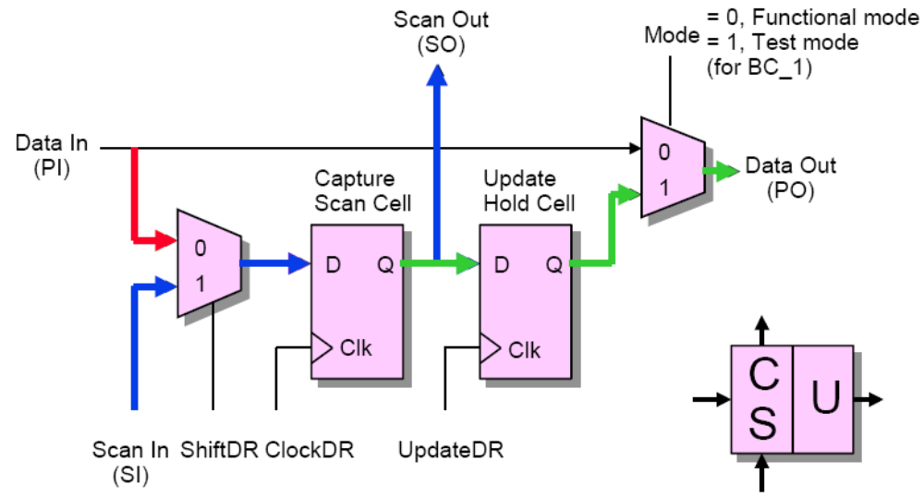
Basic Boundary Scan Cell
From: http://www.asset-intertech.com/pdfs/boundaryscan_tutorial.pdf

Slide 20
Built-in Self-Test (BIST)
Reference value
Ordinary testing
Test pattern
source
Circuit under test
(CUT)
Comparison
Pass/Fail
Built-in self-testing
Test pattern
generation
Circuit under test
(CUT)
Decision
Pass/Fail
Test patterns may be generated (pseudo)randomly – e.g., via LFSRs
Decision may be based on compressed test results
Notes:
Fujiwara, H., Logic Testing and Design for Testability, MIT Press, 1985.

Slide 21
Quantifying Testability: Controllability
Controllability C of a line has a value between 0 and 1
k-input, 1-output components
1.0
0.15
0.3
0.5
Controllability transfer factor
CTF = 1 –
N(0) = 7
N(1) = 1
CTF = 0.25
N(0) = 1
N(1) = 7
CTF = 0.25
N(0) – N(1)
N(0) + N(1)
C_{output} = (Σ_{i} C_{input i} / k) × CTF
C / (1 + log k) for each of k
C
k-way fan-out
A line with very low controllability is a good place for test point insertion
0
Control point

Slide 22
Quantifying Testability: Observability
Observability O of a line has a value between 0 and 1
k-input, 1-output components
0.15
0.6
0.15
Observability transfer factor
OTF =
0.15
N(sp)
N(sp) + N(ip)
N(sp) = 1 Sensitizations
N(ip) = 3 Inhibitions
OTF = 0.25
O_{input i} = O_{output} × OTF
1 – Π(1 – O_{j})
O_{j} for line j
k-way fan-out
A line with very low observability is a good place for test point insertion
1
Observation point

Slide 23
Quantifying Testability: Combined Measure
Testability = Controllability × Observability
Controllabilities
Observabilities
1.0
0.15
0.15
0.6
0.3
0.15
0.5
0.15
Testabilities
0.15
0.09
0.045
0.075
Overall testability of a circuit = Average of line testabilities

